Slide 1
LIFE OF CHRIST
PART 78

Slide 2
Matthew 23:1 Then Jesus spoke to the multitudes and to His disciples, ² saying: "The scribes and the Pharisees sit in Moses' seat. ³ "Therefore whatever they tell you to observe, that observe and do, but do not do according to their works; for they say, and do not do. ⁴ "For they bind heavy burdens, hard to bear, and lay them on men's shoulders; but they themselves will not move them with one of their fingers. ⁵ "But all their works they do to be seen by men. They make their phylacteries broad and enlarge the borders of their garments. ⁶ "They love the best places at feasts, the best seats in the synagogues, ⁷ "greetings in the marketplaces, and to be called by men, 'Rabbi, Rabbi.'

Slide 3
⁸ "But you, do not be called 'Rabbi'; for One is your Teacher, the Christ, and you are all brethren. ⁹ "Do not call anyone on earth your father; for One is your Father, He who is in heaven. ¹⁰ "And do not be called teachers; for One is your Teacher, the Christ. ¹¹ "But he who is greatest among you shall be your servant. ¹² "And whoever exalts himself will be humbled, and he who humbles himself will be exalted. ¹³ "But woe to you, scribes and Pharisees, hypocrites! For you shut up the kingdom of heaven against men; for you neither go in yourselves, nor do you allow those who are entering to go in.

Slide 4
¹⁴ "Woe to you, scribes and Pharisees, hypocrites! For you devour widows' houses, and for a pretense make long prayers. Therefore you will receive greater condemnation. ¹⁵ "Woe to you, scribes and Pharisees, hypocrites! For you travel land and sea to win one proselyte, and when he is won, you make him twice as much a son of hell as yourselves. ¹⁶ "Woe to you, blind guides, who say, 'Whoever swears by the temple, it is nothing; but whoever swears by the gold of the temple, he is obliged to perform it.' ¹⁷ "Fools and blind! For which is greater, the gold or the temple that sanctifies the gold? ¹⁸ "And, 'Whoever swears by the altar, it is nothing; but whoever swears by the gift that is on it, he is obliged to perform it.'

Slide 5
¹⁹ "Fools and blind! For which is greater, the gift or the altar that sanctifies the gift? ²⁰ "Therefore he who swears by the altar, swears by it and by all things on it. ²¹ "He who swears by the temple, swears by it and by Him who dwells in it. ²² "And he who swears by heaven, swears by the throne of God and by Him who sits on it. ²³ "Woe to you, scribes and Pharisees, hypocrites! For you pay tithe of mint and anise and cummin, and have neglected the weightier matters of the law: justice and mercy and faith. These you ought to have done, without leaving the others undone. ²⁴ "Blind guides, who strain out a gnat and swallow a camel!

Slide 6
²⁵ "Woe to you, scribes and Pharisees, hypocrites! For you cleanse the outside of the cup and dish, but inside they are full of extortion and self-indulgence. ²⁶ "Blind Pharisee, first cleanse the inside of the cup and dish, that the outside of them may be clean also. ²⁷ "Woe to you, scribes and Pharisees, hypocrites! For you are like whitewashed tombs which indeed appear beautiful outwardly, but inside are full of dead men's bones and all uncleanness. ²⁸ "Even so you also outwardly appear righteous to men, but inside you are full of hypocrisy and lawlessness. ²⁹ "Woe to you, scribes and Pharisees, hypocrites! Because you build the tombs of the prophets and adorn the monuments of the righteous,

Slide 7
³⁰ "and say, 'If we had lived in the days of our fathers, we would not have been partakers with them in the blood of the prophets.' ³¹ "Therefore you are witnesses against yourselves that you are sons of those who murdered the prophets. ³² "Fill up, then, the measure of your fathers' guilt. ³³ "Serpents, brood of vipers! How can you escape the condemnation of hell? ³⁴ "Therefore, indeed, I send you prophets, wise men, and scribes: some of them you will kill and crucify, and some of them you will scourge in your synagogues and persecute from city to city,

Slide 8
³⁵ "that on you may come all the righteous blood shed on the earth, from the blood of righteous Abel to the blood of Zechariah, son of Berechiah, whom you murdered between the temple and the altar. ³⁶ "Assuredly, I say to you, all these things will come upon this generation. ³⁷ " O Jerusalem, Jerusalem, the one who kills the prophets and stones those who are sent to her! How often I wanted to gather your children together, as a hen gathers her chicks under her wings, but you were not willing! ³⁸ "See! Your house is left to you desolate; ³⁹ "for I say to you, you shall see Me no more till you say, 'Blessed is He who comes in the name of the LORD!' “

Slide 9
1. The evil way needs to be exposed.
Amos 5:15 Hate evil, love good;
Romans 12:9 Let love be without hypocrisy. Abhor what is evil. Cling to what is good.
Ephesians 5:11 And have no fellowship with the unfruitful works of darkness, but rather expose them.

Slide 10
2. The people needed to see what kind of men these were so they could know that what they were doing was sinful.

Slide 11
1 Timothy 5:19 Do not receive an accusation against an elder except from two or three witnesses. ²⁰ Those who are sinning rebuke in the presence of all, that the rest also may fear.

Slide 12
Galatians 2:11 Now when Peter had come to Antioch, I withstood him to his face, because he was to be blamed; ¹² for before certain men came from James, he would eat with the Gentiles; but when they came, he withdrew and separated himself, fearing those who were of the circumcision. ¹³ And the rest of the Jews also played the hypocrite with him, so that even Barnabas was carried away with their hypocrisy. ¹⁴ But when I saw that they were not straightforward about the truth of the gospel, I said to Peter before them all, "If you, being a Jew, live in the manner of Gentiles and not as the Jews, why do you compel Gentiles to live as Jews?

Slide 13
¹⁵ "We who are Jews by nature, and not sinners of the Gentiles, ¹⁶ "knowing that a man is not justified by the works of the law but by faith in Jesus Christ, even we have believed in Christ Jesus, that we might be justified by faith in Christ and not by the works of the law; for by the works of the law no flesh shall be justified. ¹⁷ "But if, while we seek to be justified by Christ, we ourselves also are found sinners, is Christ therefore a minister of sin? Certainly not! ¹⁸ "For if I build again those things which I destroyed, I make myself a transgressor. ¹⁹ "For I through the law died to the law that I might live to God.

Slide 14
²⁰ "I have been crucified with Christ; it is no longer I who live, but Christ lives in me; and the life which I now live in the flesh I live by faith in the Son of God, who loved me and gave Himself for me. ²¹ "I do not set aside the grace of God; for if righteousness comes through the law, then Christ died in vain."

Slide 15
3. The Scribes and Pharisees needed to repent.
Proverbs 9:8 … Rebuke a wise man, and he will love you. ⁹ Give instruction to a wise man, and he will be still wiser; Teach a just man, and he will increase in learning.
Proverbs 28:23 He who rebukes a man will find more favor afterward Than he who flatters with the tongue.

Slide 16
Psalm 141:5 Let the righteous strike me; It shall be a kindness. And let him rebuke me; It shall be as excellent oil; Let my head not refuse it. For still my prayer is against the deeds of the wicked.

Slide 17
Matthew 23:1 Then Jesus spoke to the multitudes and to His disciples, ² saying: "The scribes and the Pharisees sit in Moses' seat. ³ "Therefore whatever they tell you to observe, that observe and do, but do not do according to their works; for they say, and do not do.

Slide 18
The ESV says: For they preach, but do not practice.

Slide 19
Matthew 23:4 "For they bind heavy burdens, hard to bear, and lay them on men's shoulders; but they themselves will not move them with one of their fingers.

Slide 20
Acts 15:10 "Now therefore, why do you test God by putting a yoke on the neck of the disciples which neither our fathers nor we were able to bear?

Slide 21
Matthew 23:5 "But all their works they do to be seen by men. They make their phylacteries broad and enlarge the borders of their garments. ⁶ "They love the best places at feasts, the best seats in the synagogues, ⁷ "greetings in the marketplaces, and to be called by men, 'Rabbi, Rabbi.'

Slide 22
Phylacteries were small leather boxes containing Scripture, which the Jews wore on their foreheads and left arms. Michael J. Wilkins described two intact phylactery cases, as well as fragments of others, that were discovered at Qumran in Cave 1. One type was about an inch long, with four small compartments for housing four tiny scrolls. On these would have been written Exodus 13:9, 16; Deuteronomy 6:8, 11:18 respectively. This type of phylactery was worn on the forehead. The other type was about 1/3 inch and had only one compartment. One tiny scroll would have contained all four verses in minute script. This phylactery was worn on the left arm (Truth for today commentary on Matthew p.277).

Slide 23
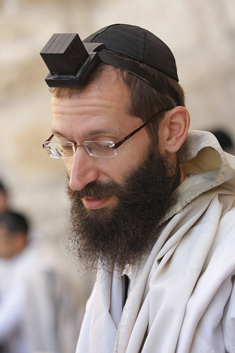
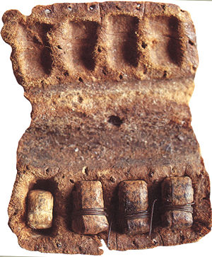

Slide 24
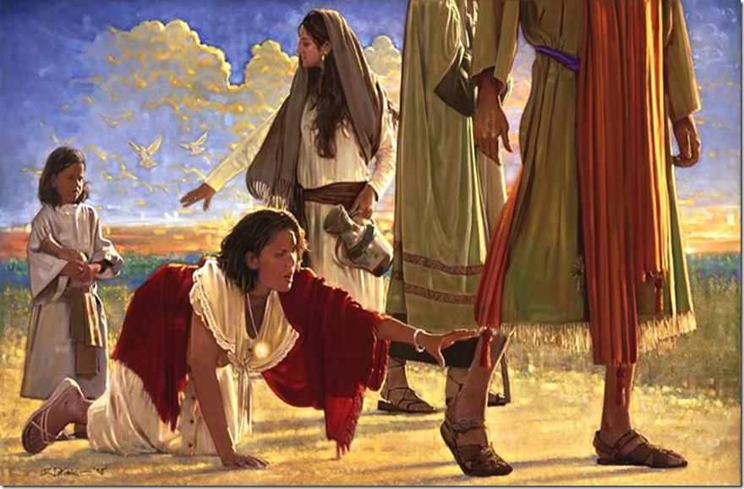

Slide 25
Mark 12:38 Then He said to them in His teaching, "Beware of the scribes, who desire to go around in long robes, love greetings in the marketplaces, ³⁹ "the best seats in the synagogues, and the best places at feasts, ⁴⁰ "who devour widows' houses, and for a pretense make long prayers. These will receive greater condemnation."

Slide 26
Matthew 23:8 "But you, do not be called 'Rabbi'; for One is your Teacher, the Christ, and you are all brethren. ⁹ "Do not call anyone on earth your father; for One is your Father, He who is in heaven. ¹⁰ "And do not be called teachers; for One is your Teacher, the Christ. ¹¹ "But he who is greatest among you shall be your servant. ¹² "And whoever exalts himself will be humbled, and he who humbles himself will be exalted.

Slide 27
When Jesus said not to call people “father,” or “leader,” it was not a condemnation of those terms in every case. The New Testament refers to those who do the work of a “teacher” (Eph. 13:17, 24), and there is nothing wrong with calling your male parent your “father” (Eph. 6:2). Paul refereed to himself as the spiritual “father” of those whom he taught (1 Cor. 4:15 – but they still did not bestow on him the title of “Father Paul.” Rather, Christ was condemning the use of religious titles: using special designations to elevate a “select few” above the rest. Jesus emphasized, “You are all brothers.” The great apostle was just “brother Paul” (Rom. 16:1). This kind of family terminology should e sufficient for any Christian. (The Life of Christ 2, p. 311)

Slide 28
Matthew 20:26 … whoever desires to become great among you, let him be your servant. ²⁷ "And whoever desires to be first among you, let him be your slave -- ²⁸ "just as the Son of Man did not come to be served, but to serve, and to give His life a ransom for many."

